Slide 1

Book cover for Understanding Medical-Surgical Nursing, Seventh Edition.
Chapter 6
Nursing Care of Patients with Fluid, Electrolyte, and Acid–Base Imbalances

Slide 2
Learning Outcomes
Identify the purposes of fluids and electrolytes in the body.
List the signs and symptoms of common fluid imbalances.
Predict patients who are at the highest risk for dehydration and fluid excess.
Identify data to collect in patients with fluid and electrolyte imbalances.

Slide 3
Learning Outcomes (continued_1)
Describe therapeutic measures for patients with fluid and electrolyte imbalances.
Identify the education needs of patients with fluid imbalances.
Categorize common causes, signs and symptoms, and treatments for sodium, potassium, calcium, and magnesium imbalances.

Slide 4
Learning Outcomes (continued_2)
Identify foods that have high sodium, potassium, and calcium contents.
Give examples of common causes of acidosis and alkalosis.
Compare how arterial blood gases change for each type of acid–base imbalance.

Slide 5
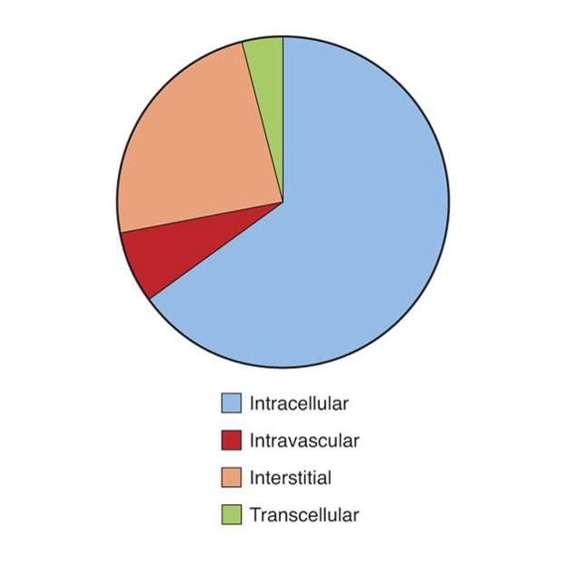
Fluid Balance
Intracellular fluid
Extracellular fluid
Interstitial fluid
Intravascular fluid
Transcellular fluid

Slide 6
Control of Fluid Balance
Pressure sensors
Antidiuretic hormone

Slide 7
Movement of Fluids and Electrolytes
Active transport
Passive transport
Diffusion
Filtration
Osmosis

Slide 8
Tonicity
Isotonic
Same osmolarity as blood
Hypertonic
Higher osmolarity than blood
Hypotonic
Lower osmolarity than blood

Slide 9
Fluid Gains and Losses
Gains
Food
Fluid
Losses
Sensible
Insensible

Slide 10
Fluid Imbalances
Dehydration
Hypovolemia
Fluid overload

Slide 11
Dehydration Signs and Symptoms
Thirst
Rapid, weak pulse
Low blood pressure
Dry skin and mucous membranes
Skin tenting
Decreased urine output
Increased temperature

Slide 12
Interventions for Deficient Fluid Volume
Monitor daily weight.
Monitor intake and output.
Increase fluid intake.
Treat underlying cause.
Use caution with elderly patients.

Slide 13
Fluid Excess Signs and Symptoms
Bounding pulse
Elevated blood pressure
Respiratory changes
Edema
Increased urine output
Weight gain
Heart failure

Slide 14
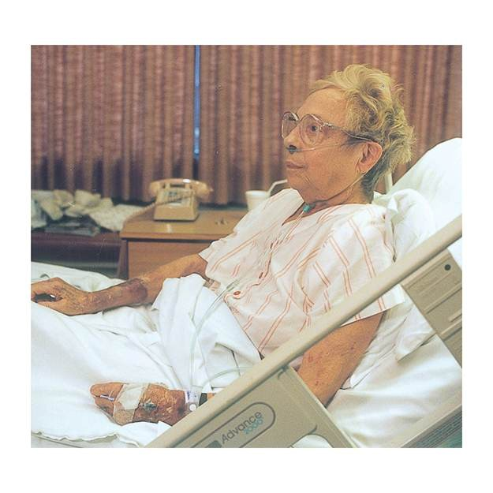
Interventions for Excess Fluid Volume
Monitor weight and urine output.
Place in Fowler position.
Administer oxygen.
Administer diuretics.
Restrict fluid and sodium.

Slide 15
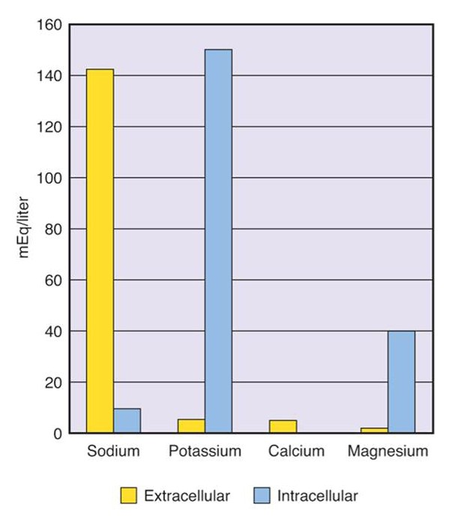
Electrolytes
Cations
Positive (+)
Anions
Negative (−)

Slide 16
Sodium Imbalances
Hyponatremia
Sodium deficit
Hypernatremia
Sodium excess

Slide 17
Food Sources of Sodium
Pizza
Canned vegetables
Canned soups
Salty snacks
Prepared foods
Na+

Slide 18
Hyponatremia Signs and Symptoms
Sodium less than 135 milliequivalents per liter
Fluid excess or deficit
Mental status changes
Weakness
Nausea and vomiting

Slide 19
Interventions for Hyponatremia
Monitor intake and output.
Monitor weight.
Restrict fluids.
Administer diuretics/steroids.

Slide 20
Hypernatremia Signs and Symptoms
Sodium greater than 145 milliequivalents/liter
Thirst
Mental status changes
Seizures
Muscle weakness
Respiratory compromise

Slide 21
Interventions for Hypernatremia
Treat fluid imbalance first.
Monitor intake and output.
Monitor weight.
Administer diuretics.
Restrict dietary sodium.
Treat cause.

Slide 22
Potassium Imbalances
Hypokalemia
Potassium deficit
Hyperkalemia
Potassium excess

Slide 23
Food Sources of Potassium
Sweet potatoes
Beet greens
Potatoes
Yogurt
Prune juice
Bananas
Orange juice
Avocados
K+

Slide 24
Hypokalemia Signs and Symptoms
Potassium (K+) lower than 3.5 milliequivalents per liter
Muscle weakness
Shallow respirations
Mental status changes
Cardiac arrhythmia and arrest

Slide 25
Interventions for Hypokalemia
Treat underlying cause.
Offer potassium-rich foods.
Administer potassium replacement.
Teach patient
Signs and symptoms to report
Self-administration of supplement

Slide 26
Hyperkalemia Signs and Symptoms
K+ greater than 5 milliequivalents per liter
Muscle twitching and cramps
Later muscle weakness
Diarrhea
Low blood pressure
Cardiac arrhythmia and arrest

Slide 27
Interventions for Hyperkalemia
Limit dietary potassium.
Hold potassium supplements.
Administer medications as ordered.
Potassium-losing diuretic
Kayexalate
Insulin with glucose

Slide 28
Calcium Imbalances
Hypocalcemia
Low calcium level
Hypercalcemia
High calcium level

Slide 29
Food Sources of Calcium
Fortified cereals
Canned salmon
Spinach
Yogurt
Cheese
Milk
Ca++

Slide 30
Hypocalcemia Signs and Symptoms
Calcium (Ca++) less than 9 milligrams per deciliter or 4.5 milliequivalents per liter
Mental status changes
Hyperactive deep tendon reflexes
Diarrhea
Cardiac arrhythmia and arrest

Slide 31
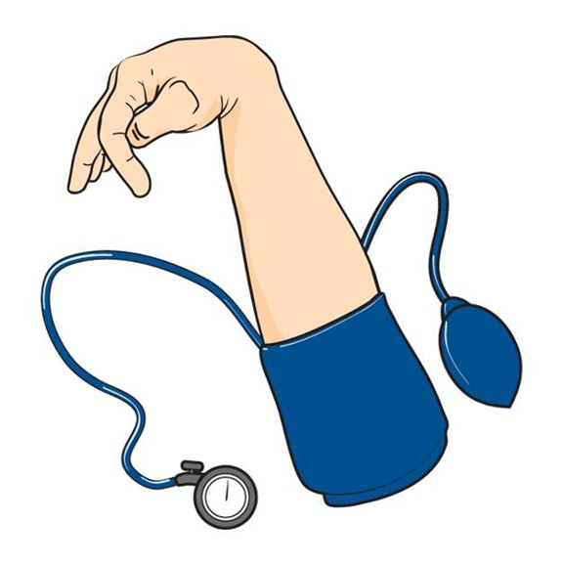

Hypocalcemia Signs and Symptoms (continued)
Trousseau sign
Chvostek sign

Slide 32
Interventions for Hypocalcemia
Treat cause.
Increase dietary calcium.
Administer medications as ordered.
IV calcium gluconate
Oral calcium supplements
Aluminum hydroxide to bind phosphate

Slide 33
Hypercalcemia Signs and Symptoms
Calcium greater than 11 milligrams per deciliter or 5.5 milliequivalents per liter
Increased heart rate and blood pressure
Skeletal muscle weakness
Decreased gastrointestinal motility

Slide 34
Interventions for Hypercalcemia
Administer fluids.
Administer medications as ordered.
Furosemide (Lasix)
Pamidronate (Aredia)
Zoledronic acid (Zometa)
Calcitonin
Hemodialysis

Slide 35
Magnesium Imbalances
Hypomagnesemia
Low magnesium level
Hypermagnesemia
High magnesium level
Mg+

Slide 36
Hypomagnesemia Signs and Symptoms
Magnesium (Mg++) less than 1.5 milliequivalents per liter
Positive Trousseau sign
Positive Chvostek sign
Cardiac arrhythmia and arrest

Slide 37
Interventions for Hypomagnesemia
Treat underlying cause.
Administer magnesium replacement.

Slide 38
Hypermagnesemia Signs and Symptoms
Magnesium greater than 2.5 milliequivalents per liter
Hypotension
Lethargy
Skeletal muscle weakness
Respiratory failure
Cardiac arrhythmia and arrest

Slide 39
Interventions for Hypermagnesemia
Administer IV fluids.
Administer medications as ordered.
Loop diuretics (Furosemide)
Dialysis

Slide 40
Acid–Base Balance
Acid
Substance that releases a hydrogen ion
Base (Alkali)
Substance that binds hydrogen
Normal pH 7.35 to 7.45

Slide 41
Acid–Base Control
Cellular buffers
Lungs
Kidneys

Slide 42
Acid–Base Imbalances
Acidosis
Alkalosis
Respiratory
Metabolic
Respiratory
Metabolic

Slide 43
Arterial Blood Gas Values: ROME
 | pH | pCO₂ | HCO₃
Respiratory Acidosis | Down arrow | Up arrow | Horizontal line
Respiratory Alkalosis | Up arrow | Down arrow | Horizontal line
Metabolic Acidosis | Down arrow | Horizontal line | Down arrow
Metabolic Alkalosis | Up arrow | Horizontal line | Up arrow

Slide 44
Review Question #1
Where are most body fluids found?
Intracellular
Interstitial
Intravascular
Transcellular

Slide 45
Review Question #1 Answer
Correct Answer: 1

Slide 46
Review Question #2
A 76-year-old patient with skin tenting and decreased urine output is most likely experiencing which fluid or electrolyte disorder?
Hypernatremia
Hypocalcemia
Fluid excess
Dehydration

Slide 47
Review Question #2 Answer
Correct Answer: 4

Slide 48
Review Question #3
Which electrolyte is most critical to healthy cardiac rhythm?
Calcium
Sodium
Potassium
Magnesium

Slide 49
Review Question #3 Answer
Correct Answer: 3

Slide 50
Review Question #4
Which interventions should the nurse initiate for a patient with fluid excess? Select all that apply.
Monitor weight.
Place in Fowler position.
Administer IV fluids.
Encourage ambulation.
Restrict fluid and sodium.

Slide 51
Review Question #4 Answer
Correct Answer: 1, 2, 5

Slide 52
Review Question #5
What are good food sources of calcium? Select all that apply.
Canned tuna
Canned salmon
Spinach
Yogurt
Whole grains

Slide 53
Review Question #5 Answer
Correct Answer: 2, 3, 4

